Slide 1
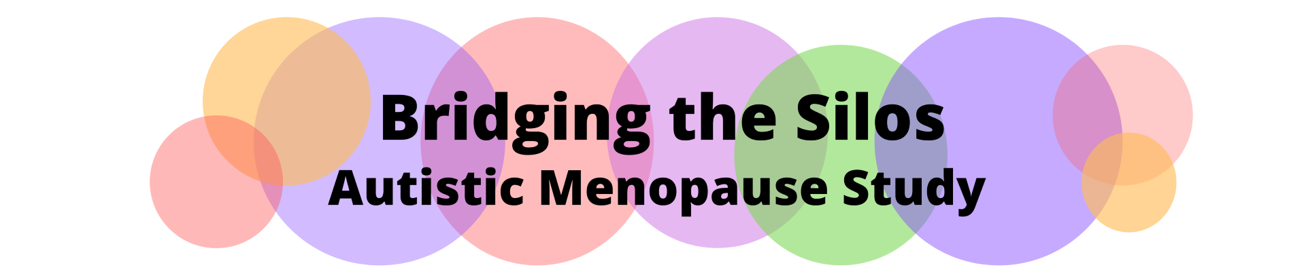
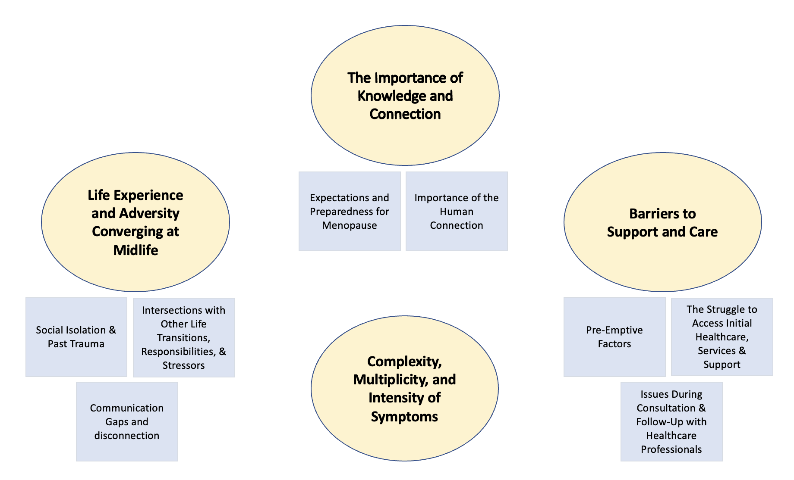
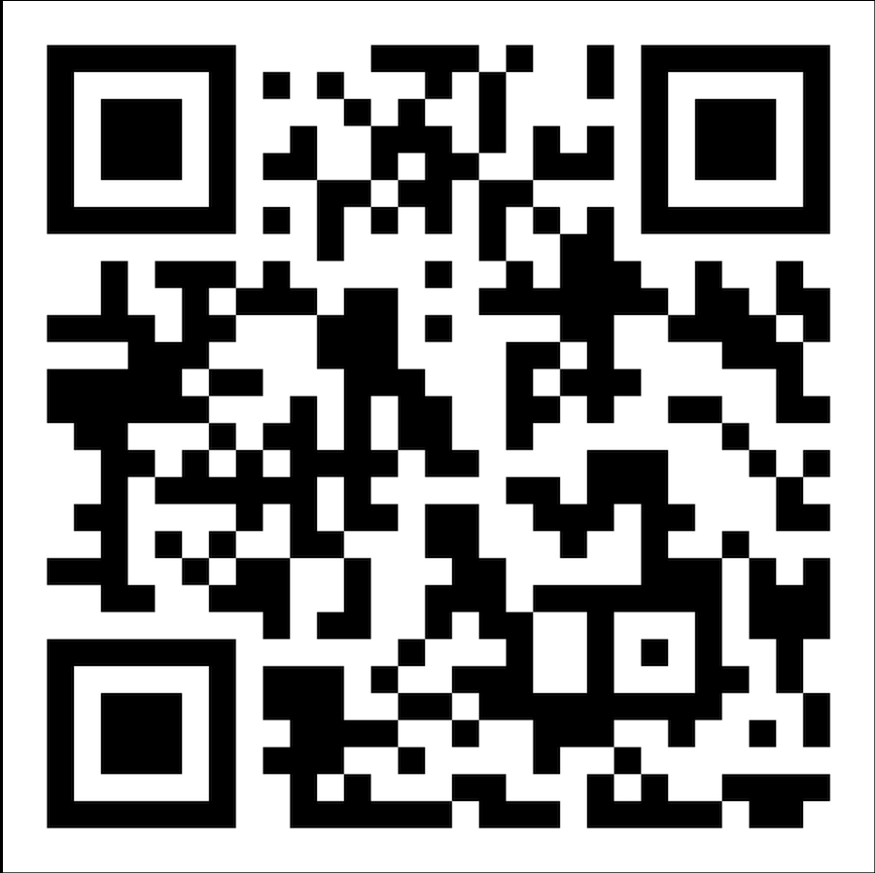
Research brief
Menopause can be very difficult for some autistic people. They may feel less alone if they share their stories.
“Just having that sense of community, having that sense of common cause, that sense of I’m not alone in this.”
4
(Autistic Research Participant – Canada)
We are a group of Autistic researchers and academics. Our study explores how Autistic people experience menopause and what support and information might help.
Our team talked with 24 Autistic people who lived in Canada or the UK. We found four themes and eight subthemes in our conversations.
We published a research article on our study in the journal Autism. It is titled
“‘A Perfect Storm’: Autistic experiences of Menopause and Midlife.”
You can access a free copy of our article here: https://tinyurl.com/42sbtfs2
For more information about the Bridging the Silos: Autistic Menopause Study, visit our website www.autisticmenopause.com or scan the QR code.

